Slide 1


LOGFAS
Logistics Planning and Execution Supporting Tools - LOGFAS
LOGFAS Section

Slide 2
What is a NATO FAS?
A NATO Functional Area Services (FAS) provides a system or series of software modules that allow the specialist areas to work together in a collective/collaborative way.
This enables the passing information between the different Divisions and Branches (CJ2, CJ3, CJ4, CJ5, etc).
They are Joint Service, Multi-National and used at all levels of planning (Strategic, Operational and Tactical)
Also used in the execution of movement/logistic operations.

Slide 3
Important Note
Information is key to any modern coalition operation but is only relevant if:
Accurate
Contains all the required elements
Understandable
Timely

Slide 4
Logistics Functional Area Services (LOGFAS)
LOGFAS provides a series of Modules used by NATO that allow for the analysis, planning, execution and reporting of M&T and Logistics, using an integrated series of computer programs.
The LOGFAS Programs/Modules use the same database format and therefore all data can be easily shared.
Data exchange can be by using the Export and Import data processes.
The programs are cleared to be issued and used by all NATO Nations, PFP and Coalition Nations.

Slide 5
Why do we use LOGFAS in NATO?
The use of LOGFAS is mandated by NATO by the MC 336 NATO Principles and Policies for Movements &Transportation (M&T).
MC 336/2 approved by North Atlantic Council (NAC).
MC 336/3 approved by Military Committee (MC).
In MC 336/3 at Paragraphs 8.3 and 8.4 it states:
“NATO Nations…. are to use LOGFAS Tools to facilitate multinational deployment planning, execution monitoring and transfer of information”.

Slide 6
Overriding Principles
That a single piece of data, once created, is used again and again:
Reduces the need for constant data recreation.
Prevents stove piping of data.
Maintains responsibilities at correct level.
Once created it can be updated or enhanced.
The same Item data can be used by all the LOGFAS Modules and for all purposes and processes.

Slide 7
Overriding Principles (Continued)
As data is passed there is clear and equal understanding regardless of how it is applied:
A Mission planned in ADAMS can be used in EVE and CORSOM to execute and report. It may need to be verified and updated. But not recreated in each Module.

Slide 8
How do we use LOGFAS?
How LOGFAS is implemented at the national level is the responsibility of the individual Nation, but it needs to be in accordance with NATO Doctrine.
Why?
In the CJ4 World you have to make many decisions and making a decision follows a thought process!
There needs to be an equal understanding of the data, regardless of the source.
To do this you need to be able to work with information and to use it to your advantage.
LOGFAS provides methods to do this.

Slide 9

LOGFAS Vs 7 (Series) Common and Specialized Software Tools
M&T
ADMIN
NS Wan
Internet
LCM
UMM
ADAMS
EVE
LOGREP
LOGBASE
CORSOM
(Functions in LDM/GeoMan)
SDM
M&T Web
ADAMS Web
CORE MODULES
GeoMan
Other Services
EVE Web
LDM
SPM

Slide 10
LOGFAS Connection Manager (LCM)
The Management of LOGFAS Databases is achieved using the LOGFAS Connection Manager (LCM) module
The LCM require the LOGFAS Manager and Sys Admin Staff to work together, so that the requirements are clearly understood and any upgrading of the LOGFAS Programs and Data Sets is achieved in a coordinated way.

Slide 11
LOGFAS Connection Manager (LCM) - Continued
The LCM can be used to connect to a:
Local Database (standalone)
Server Database (networked)
When used on a network by applying Server/Client working principles, the connection to the database is achieved using the LCM and then the individual User privileges, rights and permissions are managed using the User Management Module (UMM).

Slide 12
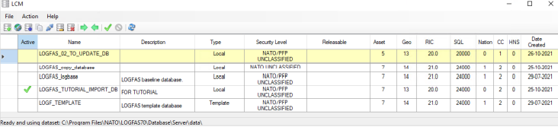
Controlled (Reference) Data Sets
LOGFAS uses a series of Controlled (or Reference) Data Sets to manage the database and data within them.
These Data Sets are Centrally Managed by Allied Command Operations (ACO) and LOGFAS will not allow data to be imported from one database to another unless All of the Data Sets are equal.

Slide 13
The Data Circle of LOGFAS - Part 1 Data exchange and planning in the National and Multi-National Arena
National Data (Systems)
Geo / Items / Forces / HNS etc.
National Factors
Headquarters
LOGFAS – LDM
Sustainment Stockpile Planning and Packaging Options (SDOS / CDOS)
LOGFAS - SPM
Resupply Planning
LOGFAS – LDM
Geo / Items Forces / HNS etc.
LOGFAS – LDM
Force Profile and Holdings
LOGFAS – LDM
Logistic Reporting
Unit

Slide 14
LOGFAS Data Modules
Geographic Manager
Maps and Map Projects
Geographical Locations (GeoLocs)
Infrastructure Data
Transportation Networks/Routes

Slide 15
Maps and Map Projects
Geographical Map Data covers the use of Map Projects and any associated Project Maps.
GeoMan can use Local Maps that are created from the Digital Chart of the World (DCW) data that is installed as part of the LOGFAS installation.
Or using Server Maps.
LOGFAS can also use Real Geography or Artificial Geography.

Slide 16
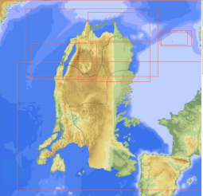
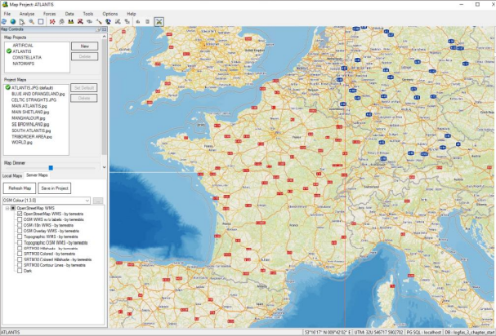

Maps and Map Projects (Continued)
Digital Charts of the World (DCW)
Server Map

Slide 17
Geographic Manager - GeoLocs
Specific location types relating to Movements and Logistic Planning.
Used to support the analysis, planning and execution work of the LOGFAS Operator.
These GeoLocs support all of the LOGFAS modules: ADAMS, EVE, CORSOM, SDM, SPM, and LDM (for LOGREP).

Slide 18
LOGFAS Data Modules (Continued)
LOGFAS Data Management (LDM)
Items of Equipment, Dimensions, Properties
Forces and Force Profiles Data, Home Bases, Unit Holdings and Hierarchical Force Organization
Consumption Data
Plans, SORs, AFLs and ADLs
Transportation Asset Data (Types and Fleet)

Slide 19
LOGFAS - Item Types
There are 5 Item Type options in LOGFAS:
CONSUMABLE MATERIAL: Munitions, Fuel, Food etc.
EQUIPMENT: Vehicles, Containerized Equipment, Weapons, Communications Equipment etc.
OTHER: Animals, Waste etc., or items that do not fall into another type.
PACKAGE: Items that are used to collate other things. E.g. Drums, Containers, Pallets, ULCs, etc.
PERSONNEL: Personnel.

Slide 20
Item Data – Reportable Item Codes (RIC)
The term RIC is a Descriptive code that shows the Capability of the Item – or what is it or what does it do!
The RICs allow the data to be integrated without the need to know individual languages or abbreviations used by services or nations.
A RIC is a six figure Alpha-Numeric Code that must be applied to the Item.
For Example: LA21CB

Slide 21
Force Data
For all LOGFAS Functions the allocation of the correct HOMEBASE (for Deployed Forces this is the Base Location in-theatre) is critical.
When creating a Force this field is mandatory.
For Maritime Forces – Remember that a Ship is both a Force and an Item.
A ship can also be a Transportation Asset.
For Air Force Units – The Aircraft (Fixed and/or Rotary Wing) can be Items and Transportation Assets.

Slide 22
Force Data (Continued)
Do not be constrained by a name; the Force List Options can also be used to represent:
Contractor Companies (especially if in the Resupply Chain or providing a Service).
Organisations – Such as Depots/Warehouses (Mil/Civ).
To provide the information that you need, a Force ID system will need to be put in to place.

Slide 23
Force Profile and Holdings Data
For LOGFAS the term Force Profile and Holdings (FPH) refers to computer representation of your Forces, in a hierarchy (if required) with the Item inventory listed against an individual Force.

Slide 24
Sustainment in LOGFAS Introduction
When Forces are deployed to a Theatre of Operations (TOO) it is not only Personnel and Equipment that needs to be planned and moved.
There is also:
The Initial (First Line) Commodities (Supplies) that may transit with the Force.
The Resupply (Second and Third Line) Commodities that will follow after the Force is Deployed.
Once the amount of supplies is calculated, it will need to be Packaged for Movement.
The LDM provides the Data Fields that allow for the calculations and Packaging options to be applied.

Slide 25
Sustainment Doctrine
Defines a consumption rate as:
The average quantity of an item consumed or expended during a given time interval.
This is normally expressed as a Standard Day of Supply (SDOS).
In LOGFAS the expression applied is Daily Consumption Rate (DCR).
There are 2 (two) main expressions used for a DOS:
Standard Day of Supply (SDOS).
Combat Day of Supply (CDOS).

Slide 26
LDM Sustainment Data – Packaging Options
When the amount of the commodity required has been calculated it may need to be Packaged for Movement (Transit).
The Packaging Options window will show all of the Commodities using the RIC and:
The Unit of Issue (Litres, Rounds, etc.), Quantity and Weight etc.
These can then be Packaged as required.
Rounds into Boxes, Boxes to Pallets, Pallets to Containers etc.
The Packages are created as Items (with the Item Type of Package applied).

Slide 27
Force Selection Process – 5 Steps
In LOGFAS the following terms are used.
Plan: A Plan identifies an operation (or other military activity, e.g. exercise). The data in LOGFAS entails specific details (e.g. Operation name, Reference date) and is also used as a framework that links and holds relevant data elements together
Statement of Requirement (SOR): This is a list of the Types of Forces that are required for an Operation and is normally created as part of the OPG process.
National Force Contribution (NFC): Consists of a Force Profile and Holdings that is prepared for the SORs the Nation (NATO element) is committing specific Forces to. It details for the NATO authority how to further allocate specific Forces to SORs.

Slide 28
SOR, AFL and ADL Data (Continued)
Allied Force List (AFL): This allocation of the Forces that Nations have made available for the Operation and then linked to the SOR.
The creation of the SOR and AFL is an Operational Planning task and is normally carried out in the TOPFAS Suite and then exported to LOGFAS.
The Forces available for allocation are normally provided as a Force Profile (which can be equally used in TOPFAS).
Allied Disposition List (ADL): The allocation of Ports (Embarkation and Debarkation) and Days are linked to the AFL.
The ability to create and maintain the SOR, AFL and ADL has been retained in LOGFAS.

Slide 29
Transport Asset Data
In LOGFAS the term Assets refers to the Transportation Assets (Aircraft (FW & RW), Ships, Trains and Road (Convoys)) that will be used to analyze the options and source (allocate transport assets) to move the Forces.
Assets are Created, Edited, Managed and Deleted in the Asset Type and Asset Fleet windows.

Slide 30
Transport Asset Data (Continued)
There are two options available for Asset data:
Asset Types: These are Templates that are used to give specific configurations for the assets.
The AAA Asset Types should not (never ever) be used for real work.
The Nation or HQ Code should be included in the Asset Type ID Code. (E.g. GBR C-130, ITA C-130).
Asset Fleet: These are the Specific (Real) Assets that will be used for the actual transport missions.

Slide 31
The Data Circle of LOGFAS – Part 2
LOGFAS – LDM
Force Profile and Holdings
LOGFAS - ADAMS
Deployment Planning
LOGFAS - EVE
Deployment Execution
MULTINATIONAL PLANNING / C2
Nat C2 and Redeployment
LOGFAS – LDM
In-Theatre
Logistic Reporting
LOGFAS – LDM
Logistic Reporting
LOGFAS – CORSOM
Deployment Reception and Onward Movement
MN C2
MN C2
LOGFAS - SDM
Supply Control
Nat C2

Slide 32
LOGFAS in the NATO Operation Planning Process (NATO OPP).
Initiation
Political Direction
Strategic Commander’s Advice
Orientation
Scale and Scope of the Operation
Commander’s Planning Guidance
Concept Development
Course of Action
Must be approved at political level
Plan Development
Force Generation
Plan Review

Slide 33
Deployment Planning Phase 4 – Plan Development (LOGFAS)
AMCC/SJLSG Develop the:
LOGFAS Version of the CJSOR.
LOGFAS Version of the Allied Force List (AFL).
LOGFAS Version of the Allied Disposition List (ADL).
If not created and passed from TOPFAS.
Receives Detailed Deployment Plans:
From Nations.
From Allied HQs.
From NFS Units

Slide 34
Overview of the Deployment Planning Process
Statement of Requirement
SOR Serial
Type Unit Required
Higher Command
Commander’s Required Delivery Date
Priority
Required Location
National Force Contributions
Force ID and Name
Homebase
Allied Force
List
Ports of Debarkation
Allied Disposition List
Sourced Deconflicted
DDP
Deconflicted
DDP
Multinational
DDP
National
DDP
DDP Cyclical Process

Slide 35
Fast Track Deployment Planning Process
Preparation and Stand-By
Statement of Requirement
CJSOR Serial
Type Unit Required
National Force Contributions
Force ID and Name
Homebase
NRF COP
Basis for CJSOR and may include additional info.
Months?
Weeks?
Generic Multinational
DDP
Generic National
DDP
Allied Disposition List
Activation
48 Hrs?
AMCC Multinational
DDP
Tailored CJSOR
SOR Serial
Type Unit Required
Higher Command
Commander’s Required Delivery Date / Priority
Required Location
1 Week?
Tailored Allied Disposition List
Ports of Debarkation
Generic Multinational
DDP
Deconflicted Multinational DDP

Slide 36







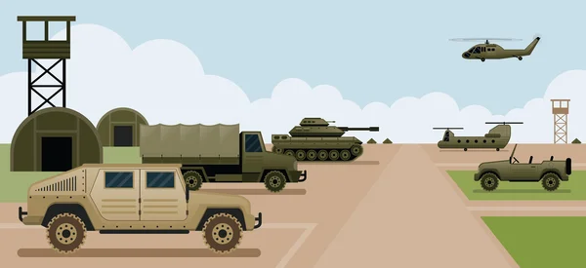
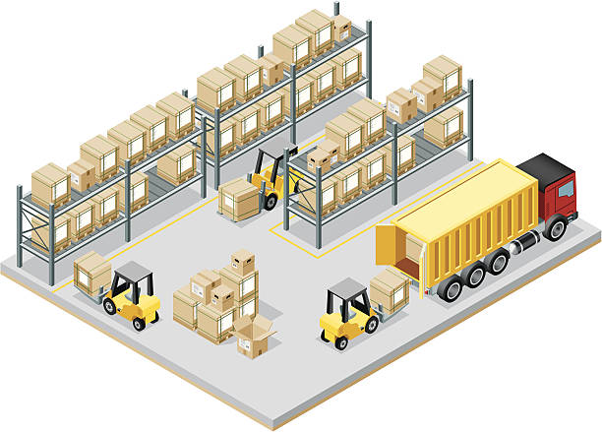
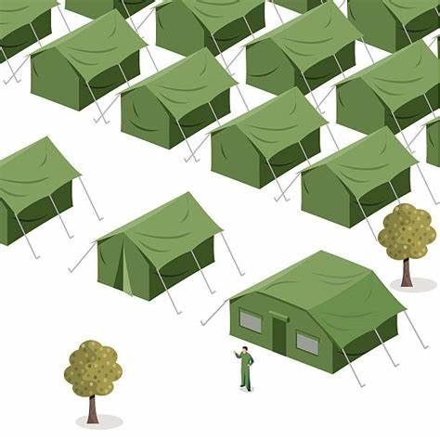


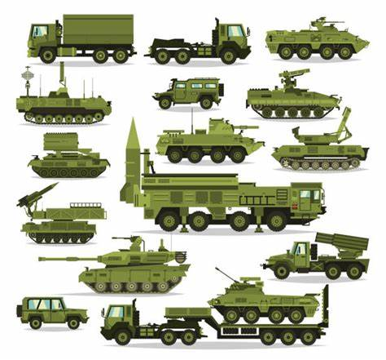


THE DEPLOYMENT PROCESS Unit Deployment Activities
Marshalling
Area
Cargo
Personnel
APOE
APOD
Homebase or
Mobilization Stations
Storage Site
Final Destination
(Assembly Area)
SPOE
SPOD
Staging Area

Slide 37
Strategic Deployment Movement Planning – Allied Deployment and Movements System (ADAMS).
An assessment tool for determining NATO mobility requirements and capabilities.
Used for planning, evaluating and simulating movement and transportation operations in support of NATO missions.
Assists planners in developing the Detailed Deployment Plan (DDP) and testing the feasibility by enabling rapid preparation, deconfliction and dissemination between nations and NATO Commands.

Slide 38
What is a DDP/DRP?
The DDP/DRP is the ADAMS data-file of what, where, when and how things are moving.
For each nation the DDP/DRP is organized by unit and the movement components (parties) of each unit.
For each movement component the DDP/DRP includes the list of personnel, equipment, supplies; the MOT, LOC and movement schedule.
The Multinational DDP/DRP is the collated and deconflicted combination of all National DDP/DRPs.

Slide 39
ADAMS – An Overview
The result being achieved by:
Splitting Forces into Movement Components
Lines of Communications (LOC)
Timing of Movements (automatically)
Transportation Requirements
Allocating Assets to Movements
Location and CRD Analysis
The same principles can also be applied for the Redeployment.

Slide 40
ADAMS – Deconfliction
Deconfliction is a mechanism that controls the approach of a number of things to a specific point or number of points.
For the Military, and in the case of movements, it is the control of Force Deployments into the Theatre Area of Operations, using specific PODs.
If time allows the Deconfliction will be carried out twice:
To Check that the Force Flow meets the CONOPS.
To Check that the Transport Asset Schedule does not exceed the Location Capacity.

Slide 41
Movement Execution and Coordination – Effective Visible Execution (EVE)
Marshalling
Area
Cargo
Personnel
APOE
APOD
EVE
Homebase or
Mobilization Stations
Storage Site
Final Destination
(Assembly Area)
SPOE
SPOD
Staging Area

Slide 42
EVE - An Overview
Provides visibility of multi-national (coalition) movement operations enabling review, prioritization and deconfliction of the force flow to (and within) the theatre.
Features:
Mission/Pax/Cargo Requesting
POE/POD Management
Mission Loading & Manifesting
Mission Execution & Reporting

Slide 43
Using EVE
As the Movement Planning is carried out in ADAMS, it became too difficult to keep updating the DDP as the Execution phase is taking place.
A need was identified to establish an easy-to-use interface between planning and execution in order to:
Share information quickly
Easy to update (MS Excel front end)
Movements Request importing/exporting
Situation projection

Slide 44
What/Who is an EVE Operator?
Each of the functions within EVE represents a responsibility within the overall process for requesting, planning and execution of movements. These areas of responsibility are maintained.
So, there is no such person as an EVE Operator, it is a number of individuals working together in a single place (EVE) in a collaborative/collective way to complete the total task (the Mission).

Slide 45
Mission/PAX/Cargo Requesting
Mission Planning
EVE Operators?
POE/D Management
Mission Loading
Multi-National
Joint Service
Multi-Modal
Terminal Operations Management
Terminal Operations (Manifesting)
Mission Execution & Reporting

Slide 46
Operational Movements Planning – Coalition Reception Staging and Onward Movement (CORSOM)
Marshalling
Area
Cargo
Personnel
APOE
APOD
Homebase or
Mobilization Stations
CORSOM
Storage Site
Final Destination
(Assembly Area)
SPOE
SPOD
Staging Area

Slide 47
CORSOM – An Overview
NATO’s tool to analyze the situation, coordinate, plan, deconflict, monitor and visualize road and rail movements from the PODs (including those in-theatre) to the Final Destination
CORSOM will support:
RSOM/RSOI Planning
RSOM/RSOI Execution
Convoy Tracking
Interoperability (iGeoSIT etc.)
An effective tool to follow ALL MOVEMENTS not just RSOM.

Slide 48
Operational Movements Planning – Coalition Reception Staging and Onward Movement (CORSOM)
CORSOM provides:
Visualisation:
Mapping, locations/facilities, network/route, distances
RSOM Planning:
Loading the DDP, generate Convoys
Analyse and adjust plans, facility requirements/overloading, route congestion
RSOM Execution:
Merging with EVE functionality
Route analysis, and alternate suggestions (incidents, Alerts, Warnings)
Reports and Charts

Slide 49
Operational Movements Planning – Coalition Reception Staging and Onward Movement (CORSOM)
Visibility
Project situational awareness at Staff and Command levels
Track convoys used other technologies (RFID)
Interoperability:
Sharing the situational awareness between Allied (and National( systems

Slide 50
Sustainment Planning Module (SPM) - Definitions
Readiness Stockpile: The calculation of Stockpile Requirements according to the principles taken in MC 55/4 (e.g. 30 x Standard Days Of Supply - SDOS).
Sustainment Stockpile: The calculation of Stockpile Requirements based on the Capability Survey (CS) planning situations and their legal combinations as denoted in the CS process (e.g. 30 x Combat Days Of Supply - CDOS).

Slide 51
Sustainment Planning Module (SPM) - Definitions (Continued)
Operational Sustainment Planning: The SPM can determine the Operational Sustainment Requirements and the Packaging Requirements for a Force or a set of Forces.
Resulting in a set of Supply Packages (Consignments) that can be added to the deployment plan along with equipment and personnel, taking into account the Supply Policies that apply.
Sustainability Analysis: For LOGREP Operators, the SPM will take a Force or set of Forces and prepares a REPORT about the duration for which the Force(s) can be sustained before the need to re-supply.

Slide 52
Supply Distribution Model (SDM) Introduction
The SDM analyses the resupply of Forces in-theatre over time.
The emphasis is on supporting “What If” analysis.
What if:
There are more/less transportation assets available
Pipelines are built
Forces move in theatre
Combat intensity or Resupply frequencies change
Etc…

Slide 53
Logistic Reporting Introduction
Provides a capability to check and update the current status of Essential and Mission Critical Items (Personnel, Equipment and Supplies) using a series of common expressions (DOS/Percentage).
By using a database, instead of spreadsheets, the information can be quickly and easily aggregated and analyzed in many different ways.
The tasks that can occur within a mission will change, so LOGREP is not fixed, the use of the system is flexible and can be adjusted to meet any situation.

Slide 54
Logistic Reporting Lessons Identified
Reports issued in different formats (MS Word, MS Excel, MS PowerPoint etc).
The Result:
Lots of effort,
High error content
Low information value
Poor data retrieval/query capability

Slide 55
NATO’s Logistic Reporting - Why?
In principle, Logistics is a collective responsibility but Nation’s are ultimately responsible for the Logistical Support of their Forces.
However, NATO Commanders, in accordance with MC 53-4 are the:
Logistic Coordinating authority for current operations.
NATO Commanders do not have re-distribution rights as routine.
This has to be agreed by the Nations, for specific periods of time and for specific items.
In order to exercise this authority they must have visibility of mission critical or essential items of equipment and supplies.

Slide 56
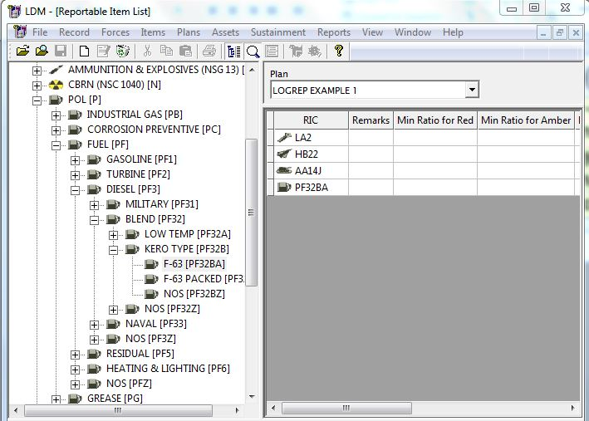
Reportable Items List (RIL)
A RIL is a list of the Capabilities that are of interest and have to be Reported.
RIC Based
RICs can be Selected at any level (all subordinates are then included).

Slide 57
NATO Doctrine
The requirements and formats for Logistic Reporting are outlined in the ACO/ACT Bi-SC Agreement.
Reporting Directive 80-3 Volume V Logistics Reports.
Peacetime - Nations to Strategic Commands:
National Peacetime LOGUPDATE
Crisis or War - National Units or Elements to the NATO authority to whom they are assigned:
Operational LOGUPDATE

Slide 58
Reporting Procedure
Agreed by the Nations (NATO Doctrine MC53-4)
Strategic Commands
JFC
Theatre
HQ
Divisional
HQ
Brigade
Details Required At All Levels
When?
Monthly, Weekly, Daily.
What?
Reportable Item List.
Where?
Geographic Locations.
Who?
Nation and Forces.

Slide 59
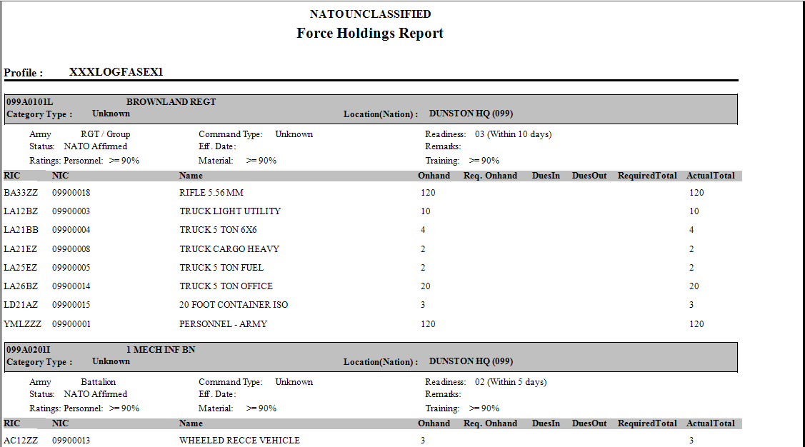
Reports
There is a good selection depending on the requirement and can be generated, printed and exported in different formats.

Slide 60
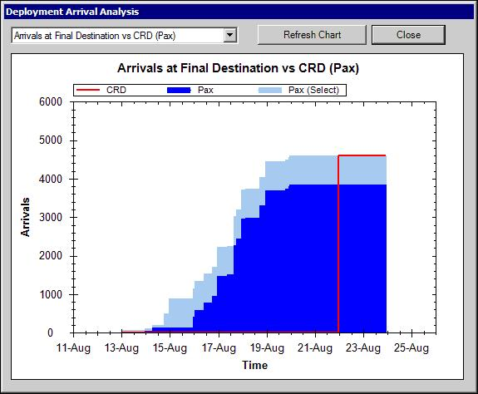
Charts
There is a good selection depending on the analysis requirement.

Slide 61
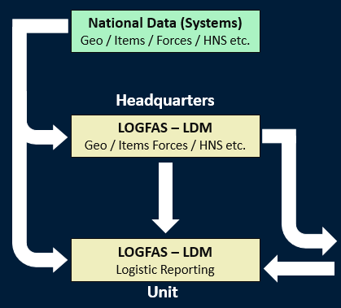

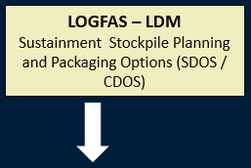

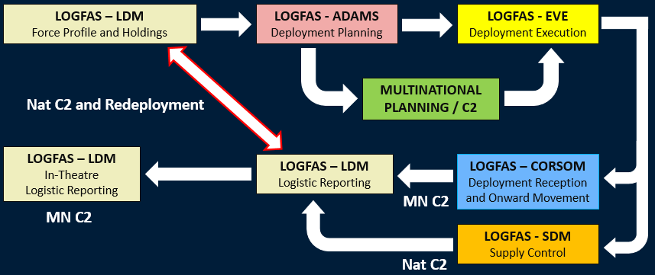
The Data Circle of LOGFAS - Completed

Slide 62
LOGNET
NS WAN:
Web URL - http://lognet.nato.int
Unclassified / NU / NR Internet:
Web URL - https://lognet.nato.int

Slide 63
Logistics (and Movements) – A perspective
Eat with Lions – Run with Gazelles (African Proverb)
Every morning in Africa a gazelle wakes up,
It knows that it must outrun the fastest lion or it will be killed.
Every morning in Africa a lion wakes up,
It knows that it must run faster than the slowest gazelle or it will starve.
It doesn’t matter whether you are a lion or a gazelle
When the sun comes up…………………..

Slide 64

You’d better be running!!

Slide 65

Any Questions

Slide 66
Contact us
nciacademy.logfas@ncia.nato.int
+351 21440 4542

